Slide 1

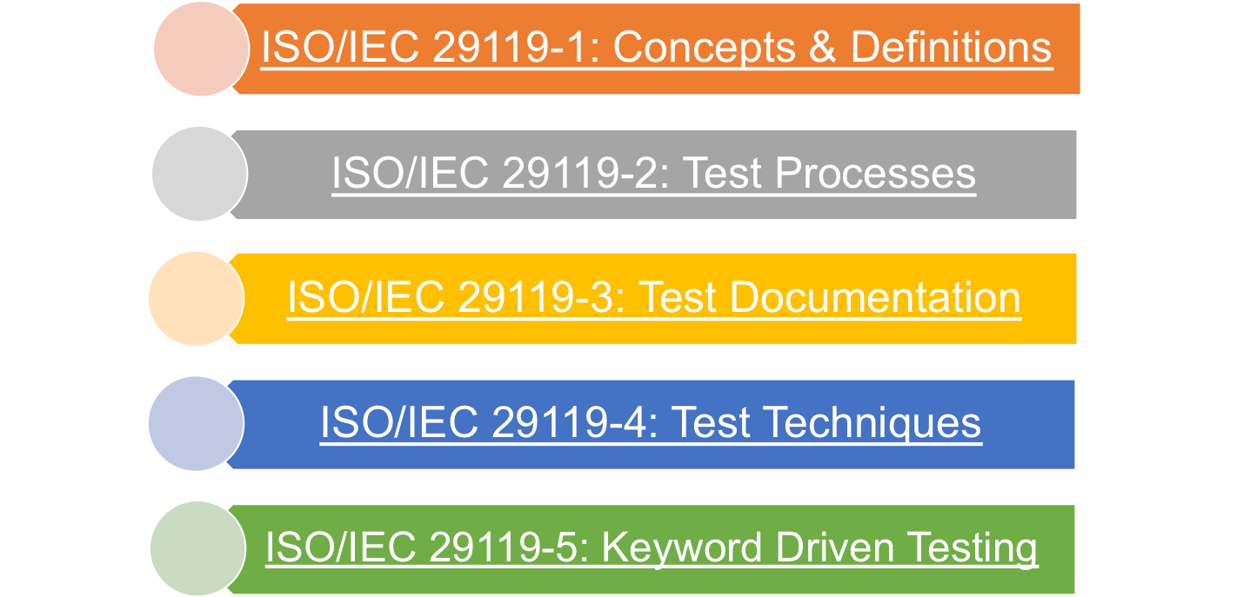
ISO/IEC/IEEE 29119 Software Testing
Consists of 5 standards applicable within any life cycle or organization
Notes:
https://www.researchgate.net/publication/323759544_Overview_of_Software_Testing_Standard_ISOIECIEEE_29119

Slide 2
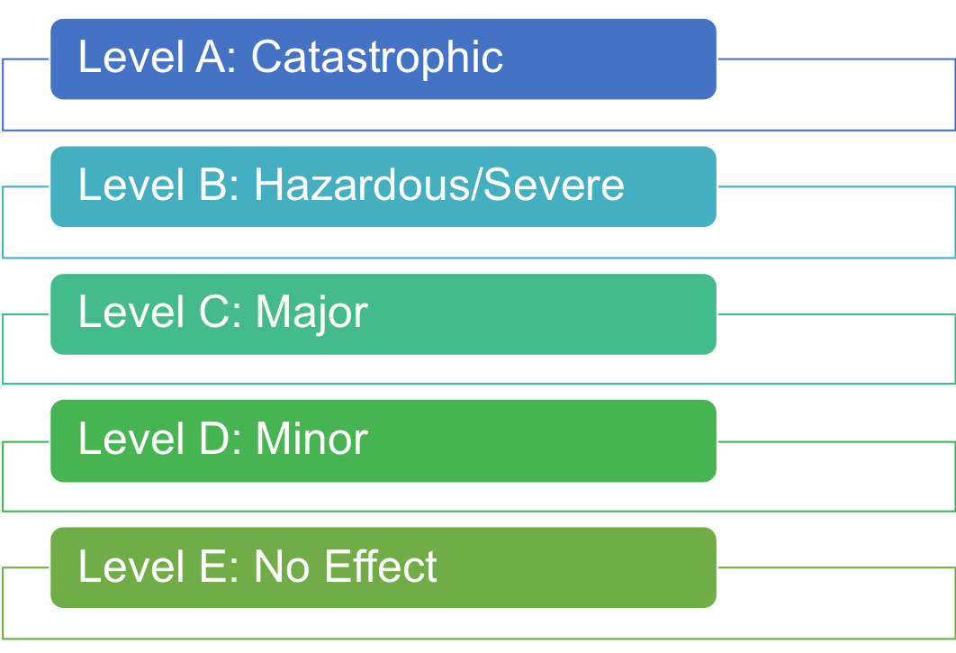
DO-178C Software Considerations in Airborne Systems and Equipment Certification
Ties testing requirements to consequences of a software error:

Slide 3
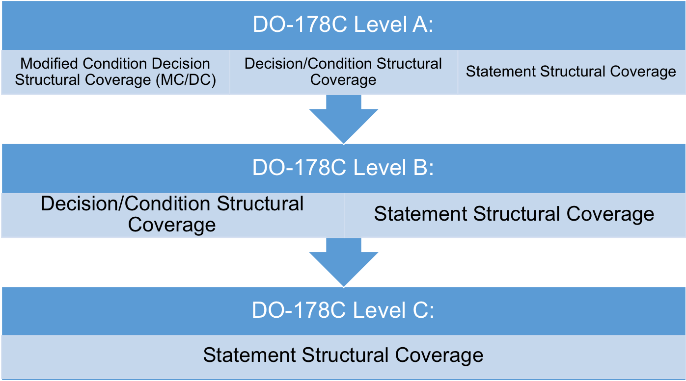
DO-178C Software Considerations in Airborne Systems and Equipment Certification
According to Criticality Levels the following test coverage is required:

Slide 4

When to Stop Testing
Out of time / money
No more defects found
Demonstrated all requirements are met
Demonstrated code coverage
Meets reliability objects
Customer is satisfied

Slide 5
ISTQB Code of Ethics
Public:
  Certified software testers shall act consistently with the public interest
Client and Employer:
  Certified software testers shall act in a manner that is in the best interests of their client and employer, consistent with the public interest

Slide 6

ISTQB Code of Ethics
Public:
  Certified software testers shall act consistently with the public interest
Client and Employer:
  Certified software testers shall act in a manner that is in the best interests of their client and employer, consistent with the public interest
Product:
  Certified software testers shall ensure that deliverables they provide (on products and systems they test) meet highest professional standards possible
Judgement:
  Certified software testers shall maintain integrity and independence in their professional judgement

Slide 7
ISTQB Code of Ethics
Management:
  Certified software test managers and leaders shall subscribe to and promote an ethical approach to management of software testing
Profession:
  Certified software testers shall advance the integrity and reputation of the profession consistent with the public interest

Slide 8

ISTQB Code of Ethics
Management:
  Certified software test managers and leaders shall subscribe to and promote an ethical approach to management of software testing
Profession:
  Certified software testers shall advance the integrity and reputation of the profession consistent with the public interest
Colleagues:
  Certified software testers shall be fair to and supportive of their colleagues, and promote cooperation with software developers
Self:
  Certified software testers shall participate in lifelong learning regarding the practice of their profession and shall promote on ethical approach to the practice of the profession

Slide 9
Summary

